Slide 1
Weather Forecasting
Project Initiation Document (PID)

Slide 2
Table of contents
Project Objective
Success Metrics
Project scope
Communication plan
Resourcing strategy
Key stakeholders
Project Risks

Slide 3
Project Objective
Goal
The goal of the weather forecasting project is to develop a web application that provides users with accurate weather information for a given location.
Usage
The application should allow users to input their desired location and retrieve the current weather conditions as well as a forecast for the upcoming hours of that day.

Slide 4
SUCCESS METRICS
Accuracy
Application Performance
User Experience
Functionality
Ensure that the weather forecasts provided by your application closely match the observed weather conditions, minimizing any discrepancies.
Monitor the response time and stability of your application to ensure it provides weather information quickly and reliably.
Focus on creating a user-friendly interface with intuitive design and smooth interactions.
Ensure that all key features, such as displaying current weather conditions and providing a forecast for the upcoming days, are working as intended.

Slide 5
PROJECT SCOPE
Develop a weather forecasting system using the API.
Integrate the API to retrieve real-time weather data for a specific location.
Implement data analysis and modeling techniques to process the API data.
Provide accurate weather predictions for temperature, humidity, precipitation, and wind speed.
Design a user-friendly interface to display the weather forecasts to users.

Slide 6
Project Overview
Stakeholders Identification
Progress Updates
Task Management
Self-review
Issue Resolution
Risk Management
COMMUNICATION
PLAN

Slide 7
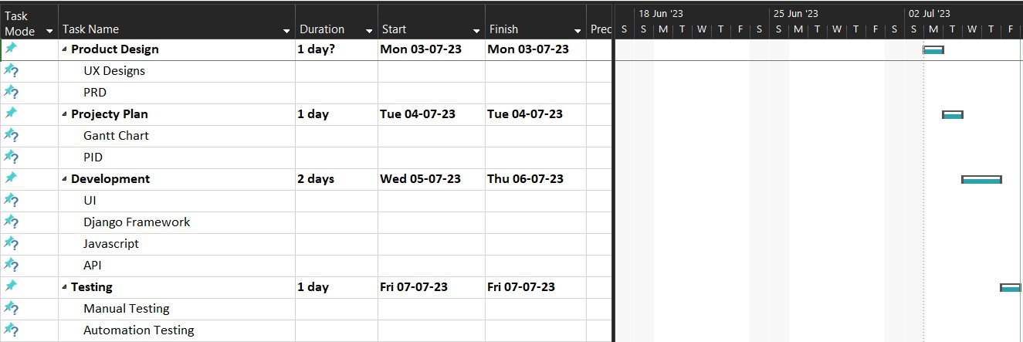
Resourcing strategy

Slide 8
Project Risks
I am displaying real time data with in my webpage through an external API
If there is no internet or any network issue happened the application will not work properly.
It also causes risk if the API that Iam exported were down

Slide 9
Thank you

